Slide 1
Employee Data Analysis using Excel
STUDENT NAME: SANDHYA KUMARI .A
REGISTER NO: autunm169525/com/22
DEPARTMENT: B.COM(GENERAL)
COLLEGE: VISHWAKSENA ARTS & SCIENCE COLLEGE FOR WOMEN

Slide 2
PROJECT TITLE
Employee Performance Analysis using Excel

Slide 3


AGENDA
Problem Statement
Project Overview
End Users
Our Solution and Proposition
Dataset Description
Modelling Approach
Results and Discussion
Conclusion
3/21/2024 Annual Review

Slide 4

PROBLEM STATEMENT
It Highlight the difficulty in accurately evaluating employee performance analysis,
Highlighting the important things to be analysed
Exit date – fill up
calculating the performance level by using formulas

Slide 5

PROJECT OVERVIEW
The project “Employee Performance analysis using Excel”aims to systematically evaluate employee productivity and effectiveness by leveraging Excel’s analytical tools.
The outcome will help in identifying top performers, recongnizing, training needs for performance improvement.
.

Slide 6

WHO ARE THE END USERS?
EMPLOYEES
MANAGERS
LEADERSHIP GROUPS
HUMAN RESOURCE

Slide 7

OUR SOLUTION AND ITS VALUE PROPOSITION
THE EMPLOYEE VALUE PROPOSITION INCLUDES;
REWARDS
RECOGNITION
STATEMENT OF THE VALUES
ENABLING THEM TO DO THEIR BEST WORK .

Slide 8
Dataset Description
Employee data set- Edunet dashboard
26 features
Features-9 features
Employee id
Gender- male ,female
Performance
Business unit
Name
Rating- numerical

Slide 9

THE "WOW" IN OUR SOLUTION
THE USE OF SLICER
THE USE OF PIVOT TABLE
3/21/2024 Annual Review
9

Slide 10
MODELLING
DATA COLLECTION
DATA CLEANING
TECHNIQUES
RESULTS
PIVOT TABLE
CHART GRAPHS
10

Slide 11
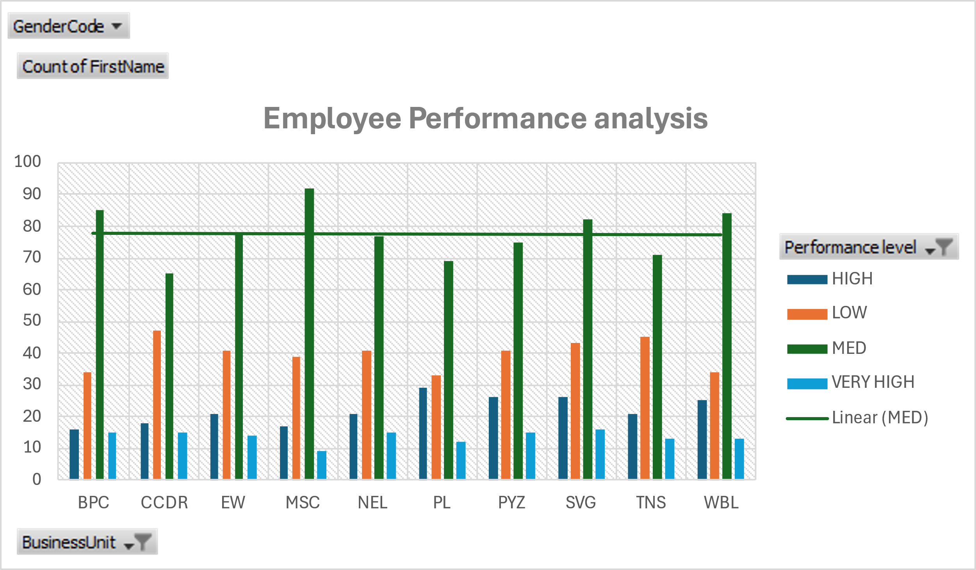
RESULTS
11

Slide 12
CONCLUSION
Existing Employee Performance analysis systems come to a conclusion Post Observing the performance of the employee. The recruitments of new employees are manually done by assessing the candidate on his/her various skills.

